Slide 1
Introduction to In-Class Project
Instructor: Dr Natasha MacBean

Slide 2
This week…
Today: Brief introduction to in-class projects, planning and questions
Class on Wednesday: Cancelled → time to work on your <=1 page project plan (due Friday 14th February at 11:59pm)

Slide 3
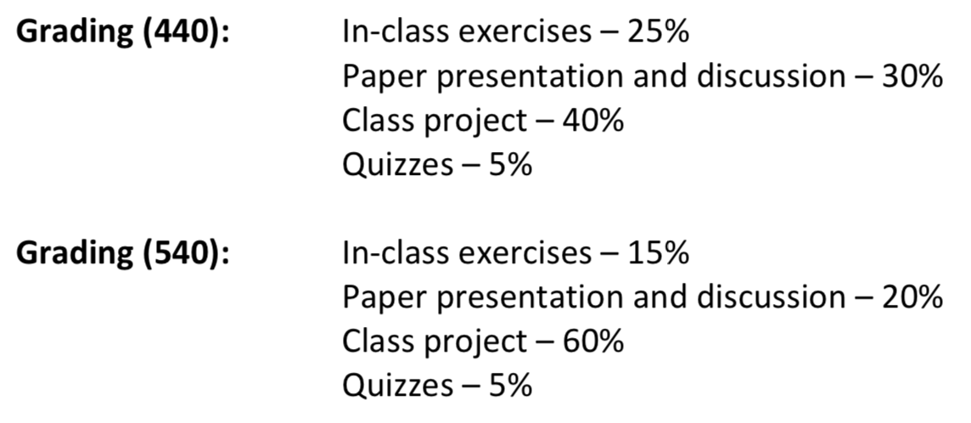
Course grading breakdown

Slide 4
Class Project – Overview
Put together a powerpoint presentation (~30-35 minutes) focusing in detail on a specific aspect of TEMs → you will present this to the rest of the class (60%)
Plus a 2-3 page literature review covering the material you cover in your presentation (30%)
10 question Quiz for rest of the class (5%)
Project Plan <=1 page (5%)
>=6 weeks (incl. spring break)
5 classes to work on class project (+ Spring Break) including this Wednesday…

Slide 5
Project Plan
Plan for topics/references you will cover due end Week 5
Detail how you will address objectives
5% of your in-class project grade
<= 1 page in word/pdf
Provide outline (essentially list of topics you’ll cover)
Provide references you will use/write literature review on
DUE: Friday 14th February at 11:59pm

Slide 6
Powerpoint presentation – objectives
Your presentation will cover the following points:
How your chosen topic (model process(es)) are represented in TEMs - overview of calculations involved
Where appropriate: different ways in which processes are implemented in different models.
How well processes are represented (e.g. model evaluation and MIPs)
Why it’s important for modeling climate and ecosystem response to global change?
Some example applications (e.g. plant hydraulics is relevant for plant responses to drought; or land cover change impacts on climate)
Advantages/disadvantages/limitations/caveats/uncertainties of how chosen topic is represented in models
Address all the learning outcomes for the course.

Slide 7
Powerpoint presentation – practicalities
60% of your in-class project grade
30-35 minutes (recommend < 1 slide/minute)
Will be asked questions at end
2 presentations per class → weeks 11-13
Graduate students first in random order
Then Undergraduates in random order

Slide 8
Literature review
30% of your in-class project grade
2-3 pages
Cover similar points to presentation (but potentially some of the points in more depth)
Due by end of Spring Break: Friday 20th March at 11:59pm

Slide 9
Quiz
10 questions based on main principles you want other students to understand
Multiple choice answers or True/False statements
5% of your in-class project grade
Questions must be submitted 1 week prior to presentation
Don’t make questions too easy or too hard!
I reserve the right to change questions if they’re too easy or too hard…

Slide 10
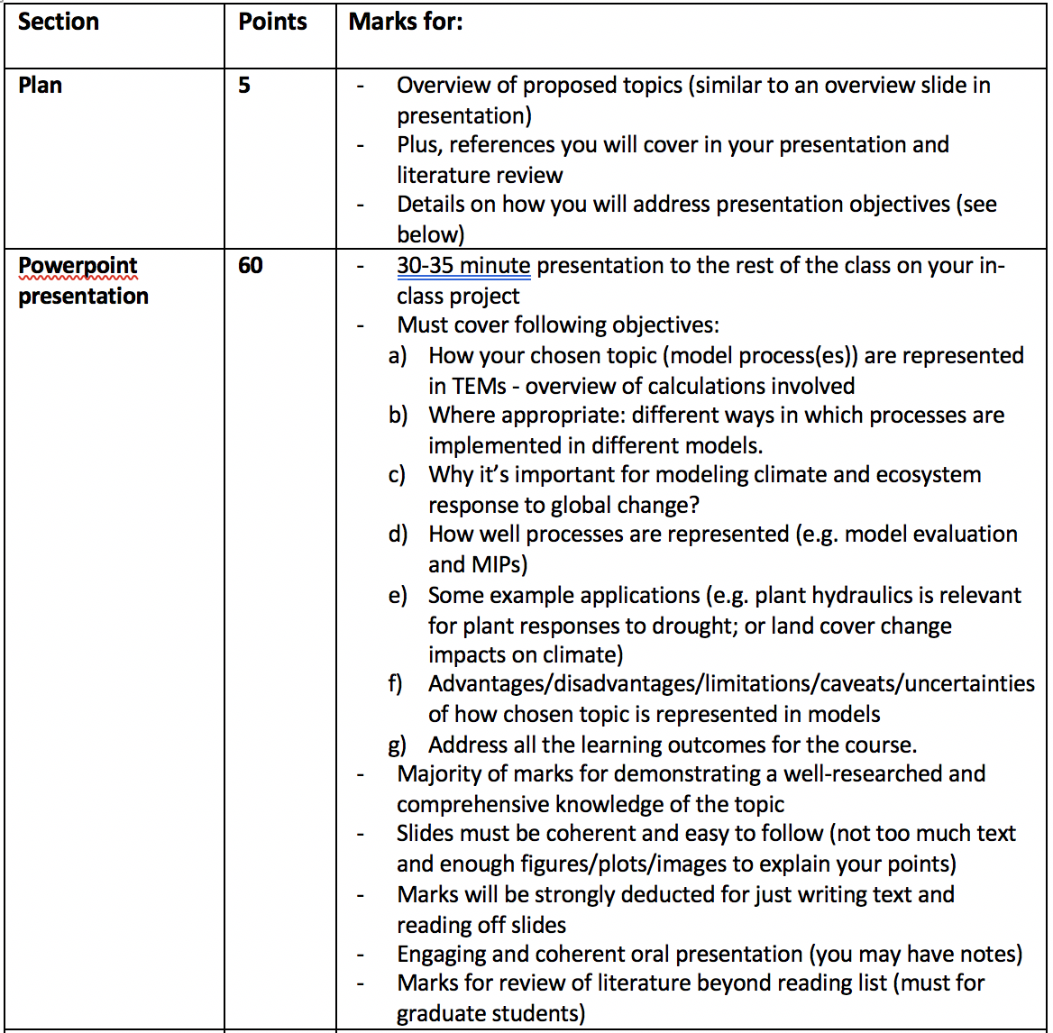
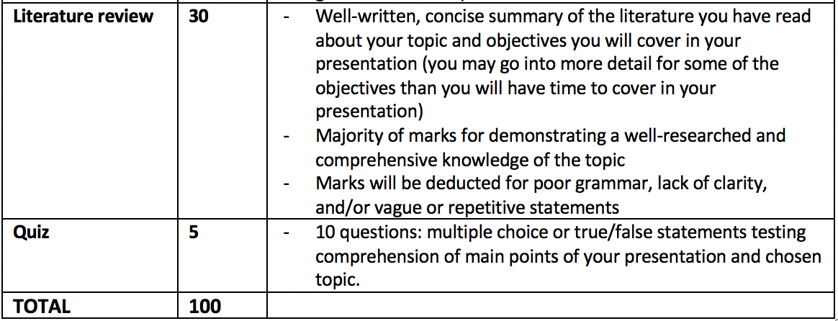
Class Project: grading rubric

Slide 11
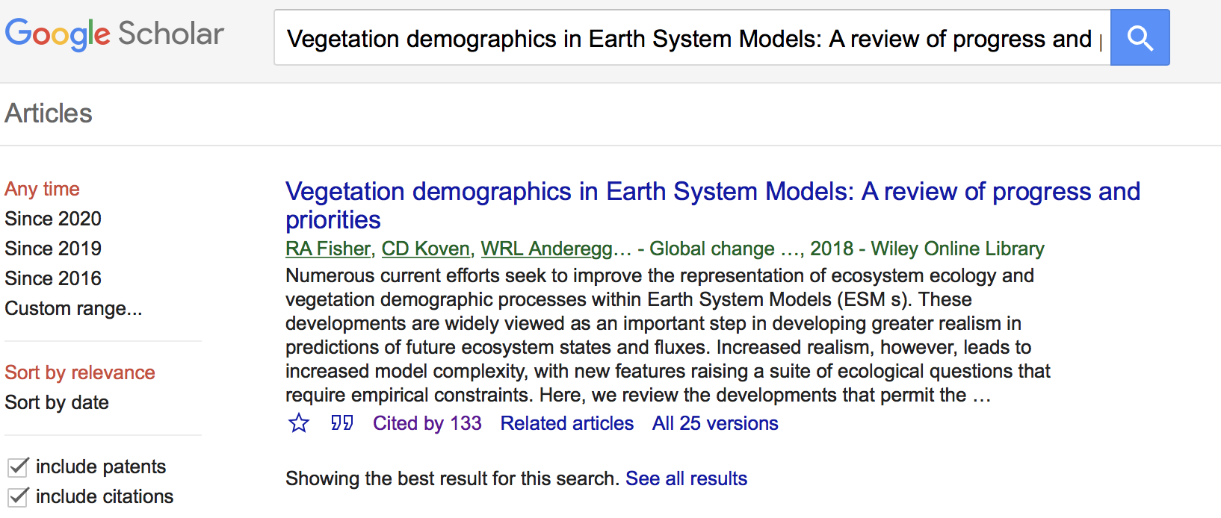
Tips for literature search
References within papers/textbook/course notes
Google scholar key words: https://scholar.google.com
Search known people in the field (from reading lists and also references cited in lecture notes)
Search citations of relevant papers

Slide 12
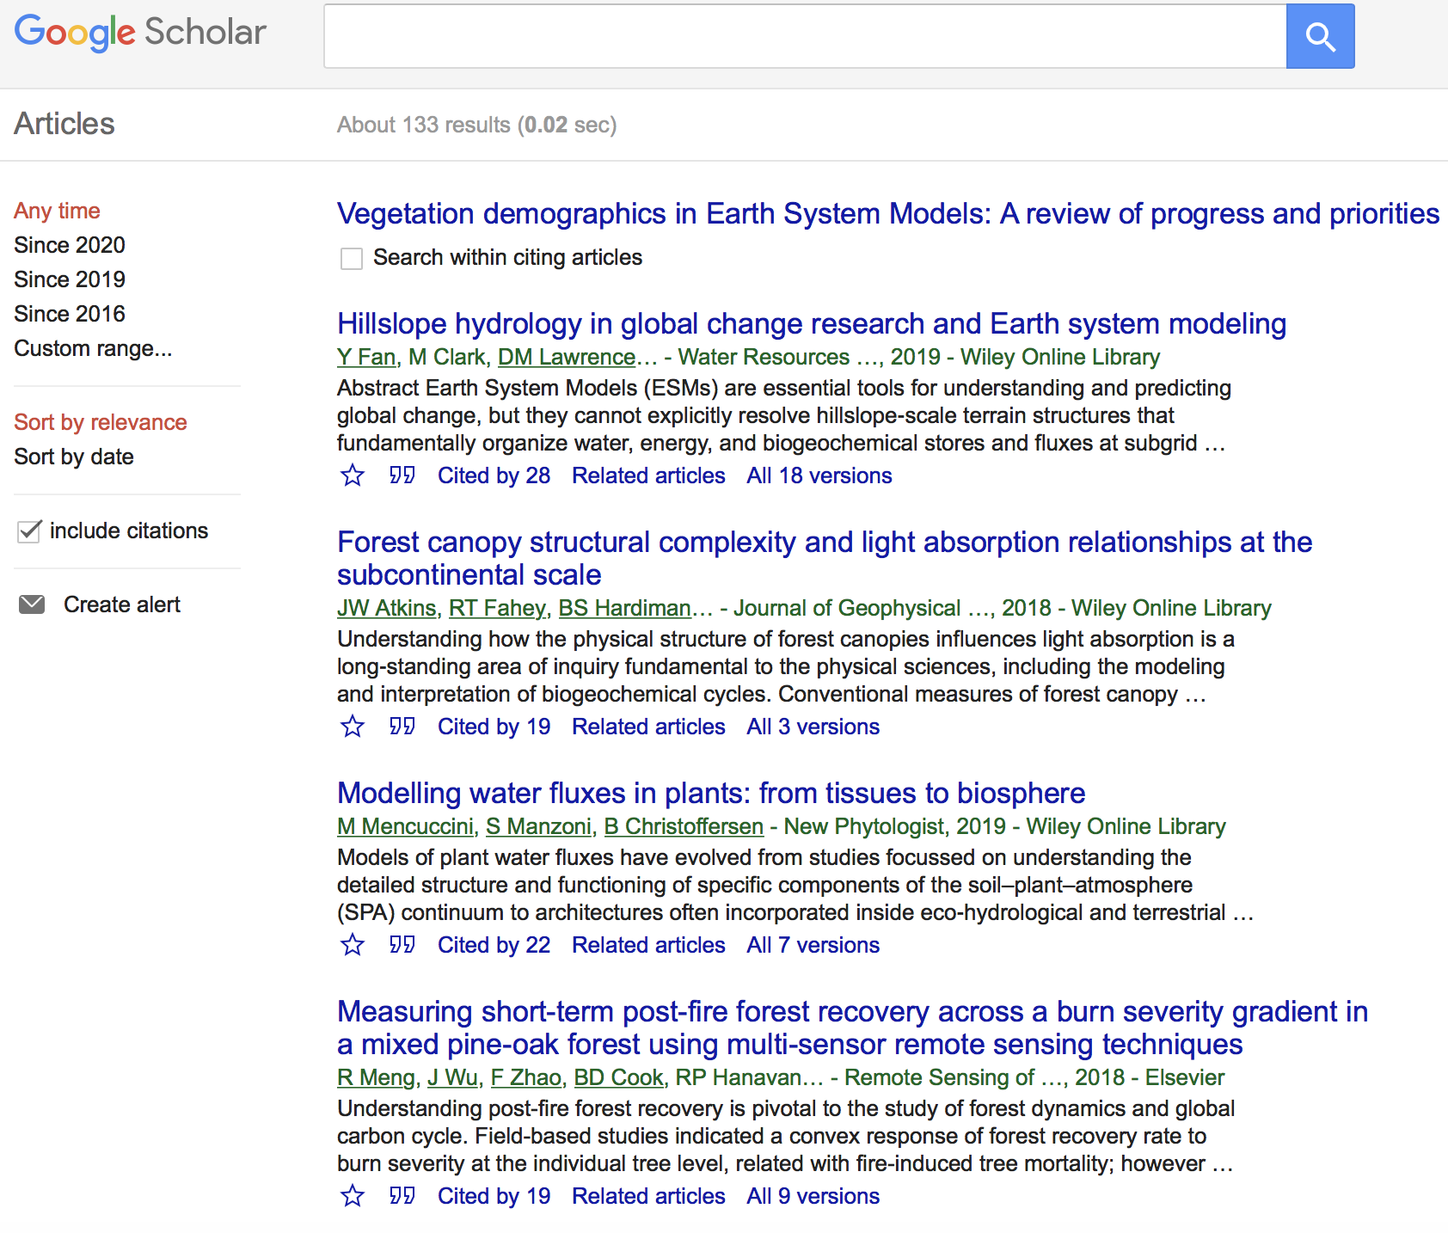
Tips for literature search

Slide 13
Tips for literature search
Two journals are key for TEM developments:
Journal of Advances in Modeling Earth Systems (JAMES): https://agupubs.onlinelibrary.wiley.com/journal/19422466 (Links to an external site.)
and
Geoscientific Model Development (GMD): https://www.geoscientific-model-development.net (Links to an external site.)
Given the fact that CMIP6 is ongoing you may find very recent articles published in JAMES or GMD that are relevant for your topic.
In terms of the two project objectives:
"Why it’s important for modeling climate and ecosystem response to global change?" and "Some example applications”
→ it may be useful to look at the last IPCC AR5 reports (published in 2013 and 2014), especially the Working Group Two report on Impacts and Adaptation. You can find all the reports here: https://www.ipcc.ch/reports/

Slide 14
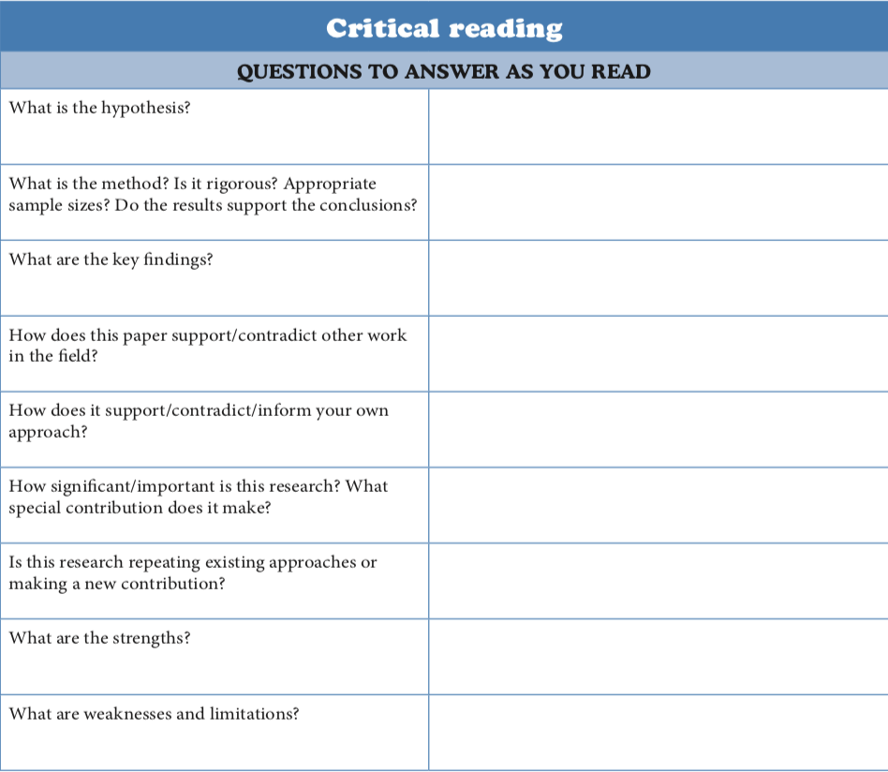
Reading scientific journal articles (papers)

